Slide 1
CASH FLOW ANALYSIS
Explain the relevance of cash flows in analyzing business activities
Describe the reporting of cash flows by business activities
Describe the preparation and analysis of the statement of cash flows
Describe alternative measures of cash flows and their usefulness

Slide 2
Statement of Cash Flows
Cash is the most liquid of assets.
Offers both liquidity and flexibility.
Both the beginning and the end of a company’s operating cycle.
Contrast: Accrual accounting and Cash basis accounting.
Net cash flow as the end measure of profitability.
Cash flow analysis helps in assessing liquidity, solvency, and financial flexibility.
Relevance of Cash

Slide 3
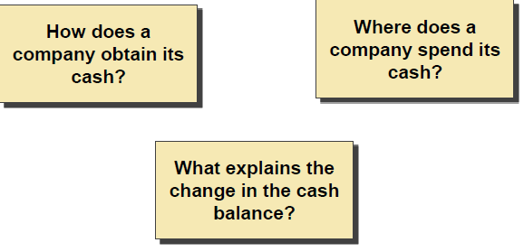
Purposes of Statement of Cash Flows

Slide 4
How much cash is generated from or used in operations?
What expenditures are made with cash form operations?
How are dividends paid when confronting an operating loss?
What is the source of cash for debt payments?
How is the increase in investments financed?
What is the source of cash for new plant assets?
Why is cash lower when income increased?
What is the use of cash received from new financing?

Slide 5
Purposes of Statement of Cash Flows
Help investors, creditors, & others to:
– Assess the enterprise’s ability to generate positive future net cash flows.
– Assess the enterprise’s ability to meet its obligations, its ability to pay dividends, & its needs for external financing.
– Assess the reasons for differences between net income & associated cash receipts & payments.

Slide 6
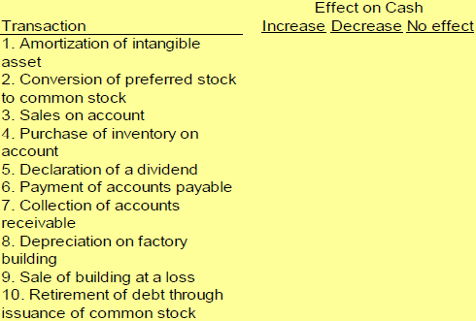
Transactions affecting cash flows - Examples

Slide 7
Classifying Cash Flows
Operating Activities
Operating activities are the earnings-related activities of a company.
Investing Activities
These activities involve assets expected to generate income for a company.
Financing Activities
Financing activities are means of contributing, withdrawing and servicing funds to support business activities.

Slide 8
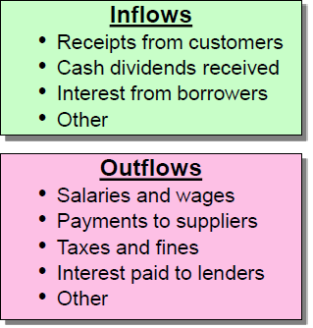
Operating Activities

Slide 9
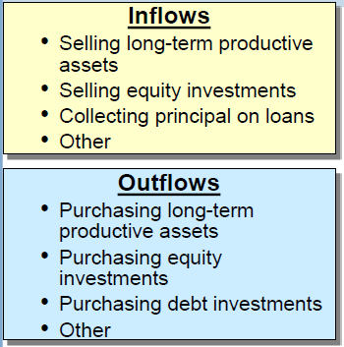
Investing activities

Slide 10
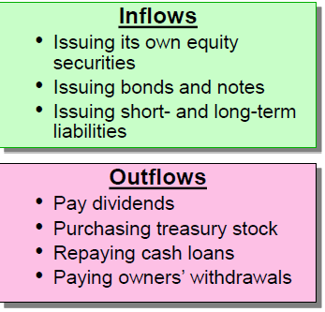
Financing activities

Slide 11
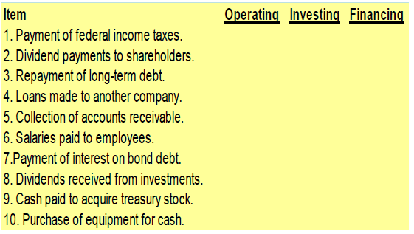
Type of activities affecting cash flow

Slide 12
Constructing the Cash Flow Statement
The indirect method
Net income is adjusted for noncash income items and accruals.
The direct method
Report gross cash receipts and cash disbursements related to operations

Slide 13
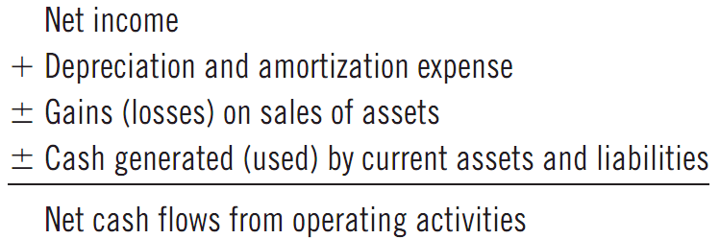
Constructing the Cash Flow Statement

Slide 14
Constructing the Cash Flow Statement

Slide 15
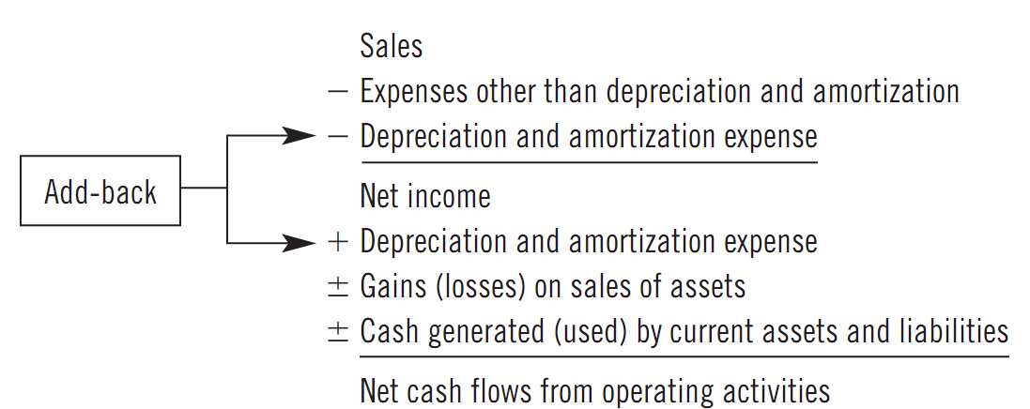
Constructing the Cash Flow Statement

Slide 16
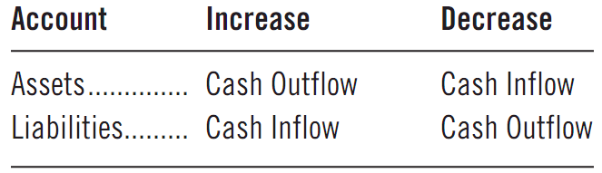
Constructing the Cash Flow Statement

Slide 17
Steps in Constructing the Statement
Start with Net Income
Adjust Net Income for non-cash expenses and gains
Recognize cash inflows (outflows) from changes in current assets and liabilities
Sum to yield net cash flows from operations
Changes in long-term assets yield net cash flows from investing activities
Changes in long-term liabilities and equity accounts yield net cash flows from financing activities
Sum cash flows from operations, investing, and financing activities to yield net change in cash
(8) Add net change in cash to the beginning cash balance to yield ending cash

Slide 18
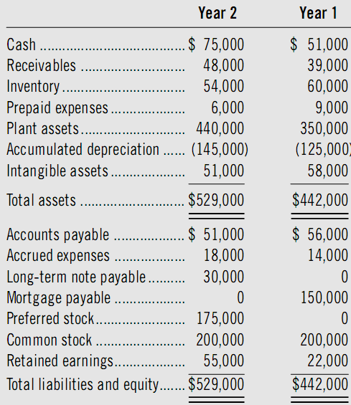

Slide 19
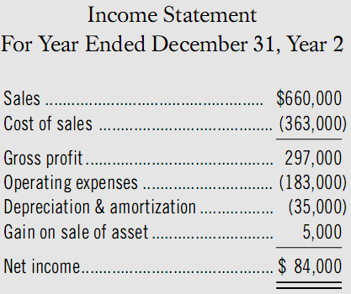

Slide 20
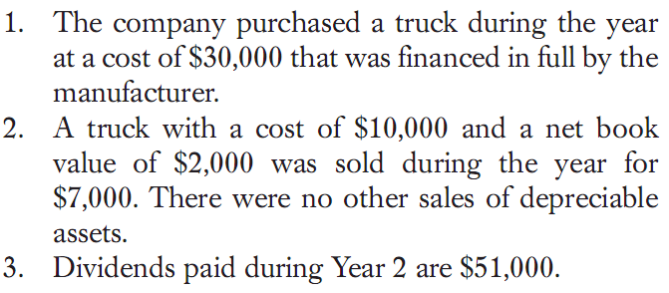
The additional information

Slide 21
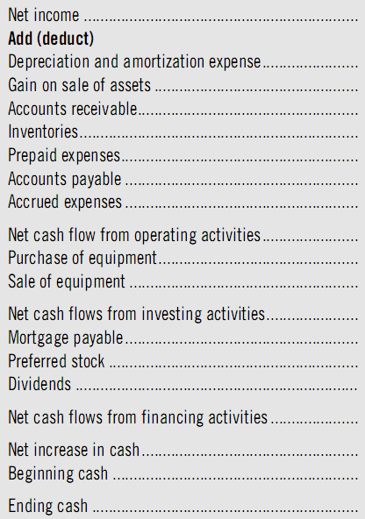

Slide 22
Analysis of Cash Flows
Establish the major past sources of cash and their uses
Estimating trends
In evaluating sources and uses of cash, the analyst should focus on questions like:
Are asset replacements financed from internal or external funds?
What are the financing sources of expansion and business acquisitions?
Is the company dependent on external financing?
What are the company’s investing demands and opportunities?
What are the requirements and types of financing?
Are managerial policies (such as dividends) highly sensitive to cash flows?

Slide 23
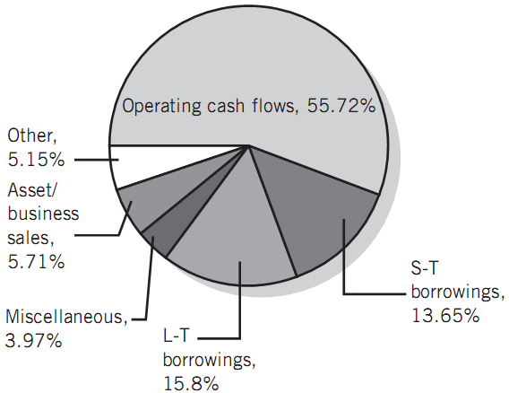
Case Analysis of Cash Flows
Major Sources of Cash for ABC
over 6 years

Slide 24
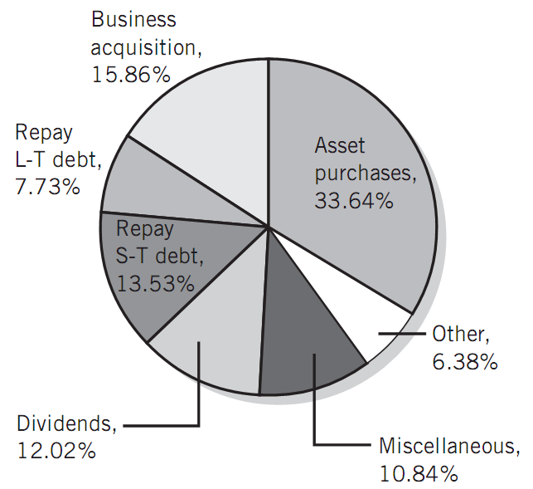
Case Analysis of Cash Flows
Major Uses of Cash for ABC
over 6 years

Slide 25
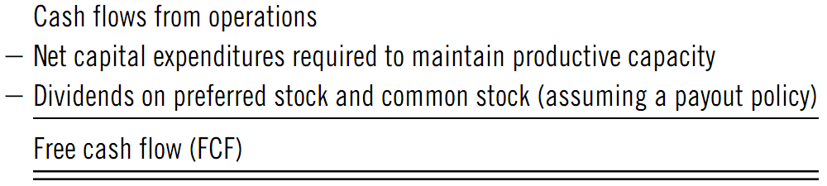
Analysis of Cash Flows
Free Cash Flow
Another definition that is widely used:
FCF = NOPAT - Change in NOA
(net operating profits after tax (NOPAT) less the increase in net operating assets (NOA))

Slide 26
Specialized Cash Flow Ratios
Cash Flow Adequacy Ratio – Measure of a company’s ability to generate sufficient cash from operations to cover capital expenditures, investments in inventories, and cash dividends:
Three-year sum of cash from operations
Three-year sum of expenditures, inventory additions, and cash dividends
Cash Reinvestment Ratio – Measure of the percentage of investment in assets representing operating cash retained and reinvested in the company for both replacing assets and growth in operations:
Operating cash flow – Dividends
Gross plant + Investment + Other assets + Working capital

